Slide 1

TCP/IP Firewall
Unit iii

Slide 2
What is Firewall ?
Firewall is a network security system that filters and controls the traffic on a predetermined set of rules. This is an intermediary system between the device and the internet.
Most of the Linux distro’s ship with default firewall tool “IPTables” provided in Linux to establish a firewall. Iptables is used to set up, maintain and inspect the tables of the IPv4 and IPv6 packet filter rules in the Linux Kernel.

Slide 3
Chains
Chains are a set of rules defined for a particular task. There are three chains(set of rules) which are used to process the traffic:-
INPUT Chains: Any traffic coming from the internet(network) towards your local machine has to go through the input chains. That means they have to go through all the rules that have been set up in the Input chain.
OUTPUT Chains: Any traffic going from your local machine to the internet needs to go through the output chains.
FORWARD Chains: Any traffic which is coming from the external network and going to another network needs to go through the forward chain. It is used when two or more computers are connected and we want to send data between them.

Slide 4
Different Policies
There are three actions which the iptables can perform on the traffic.
ACCEPT: When traffic passes the rules in its specified chain, then the iptable accepts the traffic. That means it opens up the gate and allows the person to go inside the kingdom of Thanks.
DROP: When the traffic is unable to pass the rules in its specified chain, the iptable blocks that traffic. That means the firewall is closed.
REJECT: As a general rule, use REJECT when you want the other end to know the port is unreachable’ use DROP for connections to hosts you don’t want people to see.

Slide 5
Let’s see some commands of the iptables

Slide 6
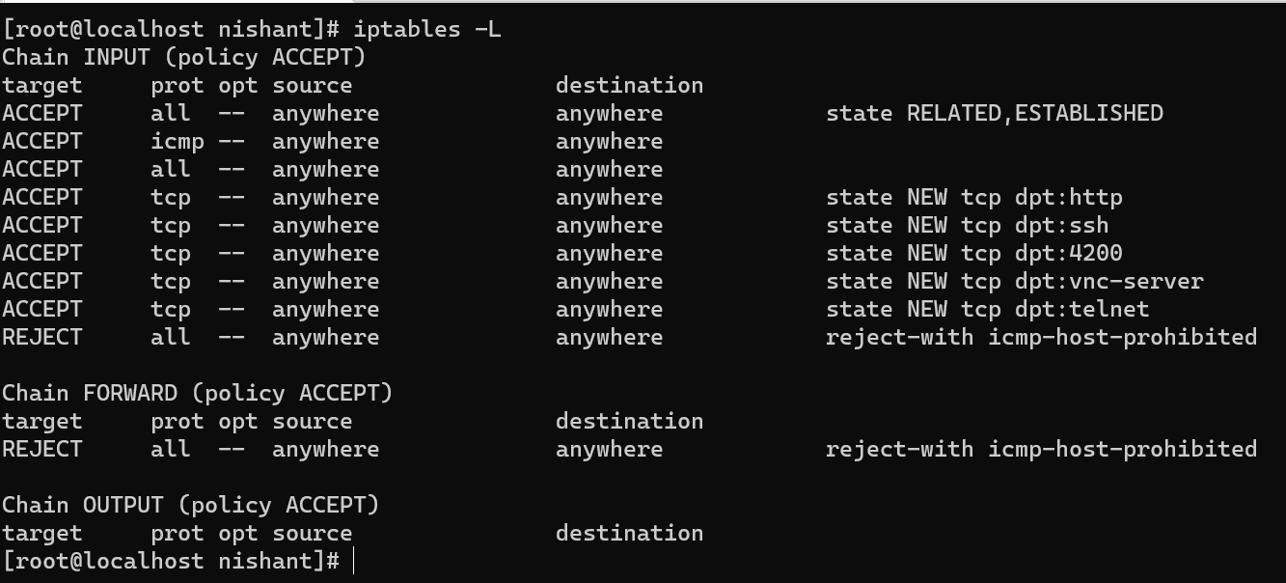
1. List the current rules of iptable :

Slide 7
…
Let see what each column mean.
Target:- This defines what action needs to be done on the packet (ACCEPT,DROP,etc..)
prot:- This defines the protocol (TCP,IP) of the packet.
source:- This tells the source address of the packet.
destination:- This defines the destination address of the packet.

Slide 8
2. Clear the rules
If you ever want to clear/flush out all the existing rules. Run the following command:-
This will reset the iptables.

Slide 9
3. Changing the default policy of chains
su iptables -P Chain_name Action_to_be_taken
As you can see in the above picture, the default policy of each of the chain is ACCEPT.
For eg:–
If you see the forward chain, you will see “Chain FORWARD (policy ACCEPT)”.This means your computer allows any traffic to be forwarded to another computer.
In order to change the policy of forwarding to drop:-
sudo iptables -P FORWARD DROP

Slide 10
RULES

Slide 11
1. Implementing a DROP rule
su iptables -A/-I chain_name -s source_ip -j action_to_take
su iptables -A INPUT -s 192.168.1.3 -j DROP
This will block the traffic coming from an IP address 192.168.1.3.
-A INPUT :- The flag -A is used to append a rule to the end of a chain.
-I INPUT:- In this flag the rules are added to the top of the chain.
-s 192.168.1.3:- The flag -s is used to specify the source of the packet. This tells the iptable to look for the packets coming from the source 192.168.1.3
-j DROP: This specifies what the iptable should do with the packet.

Slide 12
2. Implementing a ACCEPT rule
sudo iptables -A/-I chain_name -s source_ip -p protocol_name --dport port_number -j Action_to_take
sudo iptables -A INPUT -s 192.168.1.3 -p tcp --dport 22 -j ACCEPT
The above command says looks for the packets originating from the IP address 192.168.1.3, having a TCP protocol and who wants to deliver something at the port 22 of my computer. If you find those packets then Accept them.
-p protocol_name:- This option is used to match the packets that follow the protocol protocol_name.
-dport port_number: This is option is available only if you give the -p protocol_name option. It specifies to look for the packets that are going to the port “port_number”.

Slide 13
3. Deleting a rule from the iptable
su iptables -D chain_name rule_number
su iptables -D INPUT 1
If we want to delete the rule which accepts the traffic to port 22 and which we have added in the previous section.

Slide 14
IP filtering and network address translation
IP filtering and network address translation (NAT) act like a firewall to protect your internal network from intruders.
IP filtering lets you control what IP traffic and will be allowed into and out of your network. Basically, it protects your network by filtering packets according to the rules that you define.
NAT, allows you to hide your unregistered private IP addresses behind a set of registered IP addresses. This helps to protect your internal network from the outside networks. NAT also helps to alleviate the IP address depletion problem, because many private addresses can be represented by a small set of registered addresses.

Slide 15
Methods of Attacks
Port scan: To attack a PC, an intruder must determine which TCP or UDP ports (and thus services and programs) are open on that computer. Each program that connects to or accepts connections from the Internet is assigned an IP port number (0 to 65536). Port numbers often indicate a particular type of service. For example, Internet email often uses port 25 for SMTP or port 110 for POP. If you go to an FTP site to download files, your computer uses port 20 or 21. Intruders often scan (connect to multiple ports) victim computers to see which ports are active. After they identify the open ports, intruders (or their malicious programs) narrow down future attacks to a particular port type. Firewalls should notice this activity because it’s unusual for a remote computer to connect to more than a few ports at one time.

Slide 16
…
Network traffic flood: The principle behind network traffic flood attacks is that too much of a good thing can be bad. Instead of trying to determine which weaknesses exist on a given computer, special programs called flooders send hundreds to tens of thousands of legitimate network packets to one PC hoping to overwhelm the PC’s capacity to respond. This process often causes a Denial of Service (DoS) attack, but flooders have successfully bypassed firewalls and taken control of victim PCs.
Malformed network packets. Most computers are too polite. If someone sends them a badly formed network packet, they either try to reassemble it (often allowing something to sneak around a firewall or virus scanner) or reject the network packet and wait for a retransmission. Anyone who owns a Windows PC knows software programs can wait a long time. Intruders who use this type of attack are either trying to sneak past a particular security tool or cause a DoS attack by making the PC wait a long, long time and ignore legitimate packets.
Fragmentation attacks. Intruders can break up IP packets into smaller packets and reassemble them at the destination computer. Intruders have learned they can manipulate the reassembly so that they can sneak rogue traffic and programs past computer security defenses.
IP spoofing. All firewalls work by filtering network traffic based on IP addresses (e.g., 192.168.10.2). The computers behind the firewall are usually allowed to perform more functions than the untrusted computers on the outside. Rogue intruders can send their traffic with IP addresses that make the packet appear as if it originated from inside the firewall, which allows more access than would usually be allowed.
Some of these attacks are technically sophisticated and require the skills of a learned intruder. But more and more these days, worms and Trojan horses automate external attacks that scour the Internet looking for vulnerable machines. Compromised machines often are used as a staging area for more attacks against new machines. Security experts expect both manual and automated cracking to rise for the next few years until the Internet becomes more secure

Slide 17
…
Fragmentation attacks: Intruders can break up IP packets into smaller packets and reassemble them at the destination computer. Intruders have learned they can manipulate the reassembly so that they can sneak rogue traffic and programs past computer security defenses.
IP spoofing: All firewalls work by filtering network traffic based on IP addresses (e.g., 192.168.10.2). The computers behind the firewall are usually allowed to perform more functions than the untrusted computers on the outside. Rogue intruders can send their traffic with IP addresses that make the packet appear as if it originated from inside the firewall, which allows more access than would usually be allowed.

Slide 18
What is IP Masquerade?
IP Masquerade is a networking function in Linux similar to the one-to-many (1:Many) NAT (Network Address Translation) servers found in many commercial firewalls and network routers. For example, if a Linux host is connected to the Internet via PPP, Ethernet, etc., the IP Masquerade feature allows other "internal" computers connected to this Linux box (via PPP, Ethernet, etc.) to also reach the Internet as well. Linux IP Masquerading allows for this functionality even though these internal machines don't have an officially assigned IP address.

Slide 19
…
MASQ allows a set of machines to invisibly access the Internet via the MASQ gateway. To other machines on the Internet, the outgoing traffic will appear to be from the IP MASQ Linux server itself. In addition to the added functionality, IP Masquerade provides the foundation to create a HEAVILY secured networking environment. With a well built firewall, breaking the security of a well configured masquerading system and internal LAN should be considerably difficult to accomplish.

Slide 20
IP Accounting
IP Accounting (Layer 3) collects the number of bytes and packets processed by the network element on a source and destination IP address basis. Only transit traffic that enters and leaves the router is measured, and only on an outbound basis. Traffic generated by the router or traffic terminating in the router is not included in the accounting statistics. IP Accounting (Layer 3) collects individual IP address details, so it can be used to identify specific users for usage-based billing. To provide the operator with the opportunity of “snapshot” collections in the network, IP Accounting (Layer 3) maintains two accounting databases: an active database and a checkpoint database.

Slide 21
Network Address Translation
To access the Internet, one public IP address is needed, but we can use a private IP address in our private network. The idea of NAT is to allow multiple devices to access the Internet through a single public address.
Network Address Translation (NAT) is a process in which one or more local IP address is translated into one or more Global IP address and vice versa in order to provide Internet access to the local hosts.

Slide 22
Network Address Translation (NAT) working
Generally, the border router is configured for NAT i.e the router which has one interface in the local (inside) network and one interface in the global (outside) network. When a packet traverse outside the local (inside) network, then NAT converts that local (private) IP address to a global (public) IP address. When a packet enters the local network, the global (public) IP address is converted to a local (private) IP address.
If NAT runs out of addresses, i.e., no address is left in the pool configured then the packets will be dropped and an Internet Control Message Protocol (ICMP) host unreachable packet to the destination is sent.

Slide 23
NAT inside and outside addresses
Inside refers to the addresses which must be translated. Outside refers to the addresses which are not in control of an organization. These are the network Addresses in which the translation of the addresses will be done.

Slide 24
Network Address Translation (NAT) Types
Static NAT – In this, a single unregistered (Private) IP address is mapped with a legally registered (Public) IP address i.e one-to-one mapping between local and global addresses. This is generally used for Web hosting. These are not used in organizations as there are many devices that will need Internet access and to provide Internet access, a public IP address is needed. Suppose, if there are 3000 devices that need access to the Internet, the organization has to buy 3000 public addresses that will be very costly.

Slide 25
…
Dynamic NAT – In this type of NAT, an unregistered IP address is translated into a registered (Public) IP address from a pool of public IP addresses. If the IP address of the pool is not free, then the packet will be dropped as only a fixed number of private IP addresses can be translated to public addresses. Suppose, if there is a pool of 2 public IP addresses then only 2 private IP addresses can be translated at a given time. If 3rd private IP address wants to access the Internet then the packet will be dropped therefore many private IP addresses are mapped to a pool of public IP addresses. NAT is used when the number of users who want to access the Internet is fixed. This is also very costly as the organization has to buy many global IP addresses to make a pool.

Slide 26
…
Port Address Translation (PAT) – This is also known as NAT overload. In this, many local (private) IP addresses can be translated to a single registered IP address. Port numbers are used to distinguish the traffic i.e., which traffic belongs to which IP address. This is most frequently used as it is cost-effective as thousands of users can be connected to the Internet by using only one real global (public) IP address.

Slide 27
Advantages of NAT
NAT conserves legally registered IP addresses.
It provides privacy as the device’s IP address, sending and receiving the traffic, will be hidden.
Eliminates address renumbering when a network evolves.

Slide 28
Disadvantage of NAT
Translation results in switching path delays.
Certain applications will not function while NAT is enabled.
Complicates tunneling protocols such as IPsec.
Also, the router being a network layer device, should not tamper with port numbers(transport layer) but it has to do so because of NAT.

Slide 29
Thanks

